Slide 1
Chapter 11: Representation & Description
Digital Image Processing
Notes:
Department of Computer Engineering, CMU

Slide 2
Overview
representing region in 2 ways
  in terms of its external characteristics (its boundary)  focus on shape characteristics
  in terms of its internal characteristics (its region)  focus on regional properties, e.g., color, texture
sometimes, we may need to use both ways

Slide 3
Overview
Description describes the region based on the chosen representation
ex.
  representation  boundary
  description  length of the boundary, orientation of the straight line joining its extreme points, and the number of concavities in the boundary.

Slide 4
Sensitivity
feature selected as descriptors should be as insensitive as possible to variations in
  size
  translation
  rotation
following descriptors satisfy one or more of these properties.

Slide 5
Representation
Segmentation techniques yield raw data in the form of pixels along a boundary or pixels contained in a region
these data sometimes are used directly to obtain descriptors
standard uses techniques to compute more useful data (descriptors) from the raw data in order to decrease the size of data.

Slide 6
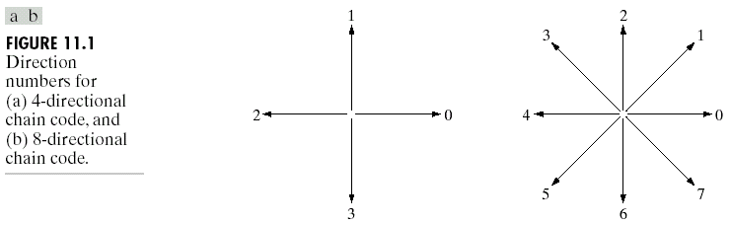
Chain codes
based on 4 or 8 connectivity

Slide 7
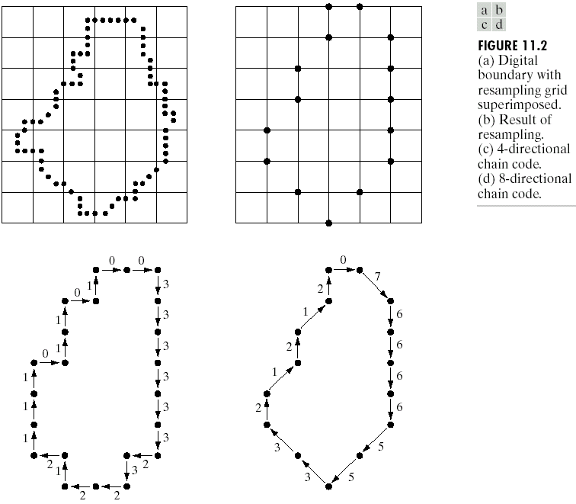

Slide 8
Chain codes
unacceptable because
  the resulting chain of codes tends to be quite long
  any small disturbances along the boundary due to noise or imperfect segmentation cause changes in the code that may not be related to the shape of the boundary

Slide 9
Chain codes
Solve the problems by
  resample the boundary by selecting a larger grid spacing
  however, different grid can generate different chain codes
starting point is arbitrary

Slide 10
Polygonal Approximations
boundary can be approximated with arbitrary accuracy by a polygon
try to capture the “essence” of the boundary shape with the fewest possible polygonal segments.
not trivial and time consuming

Slide 11
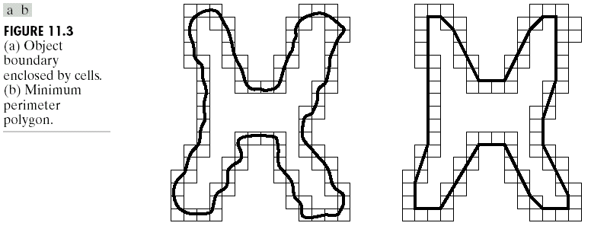
Minimum perimeter polygons

Slide 12
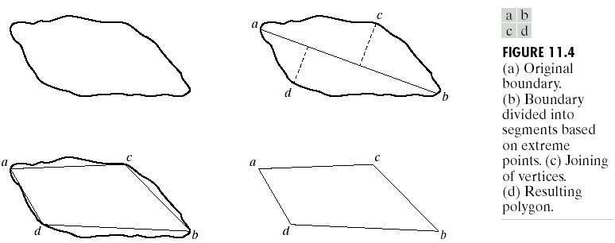
Splitting techniques
find the major axis
find minor axes which perpendicular to major axis and has distance greater than a threshold
repeat until we can’t split anymore

Slide 13
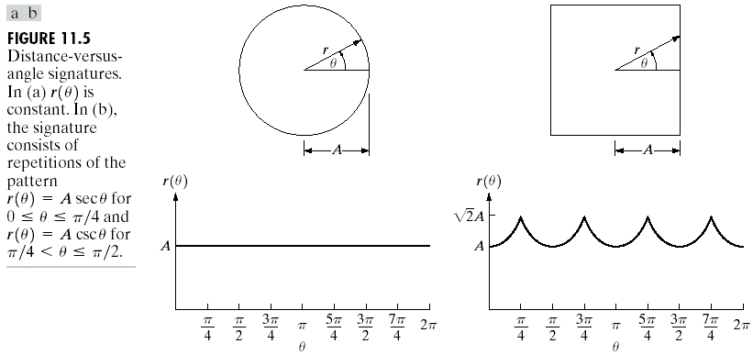
Signatures
map 2D function to 1D function

Slide 14
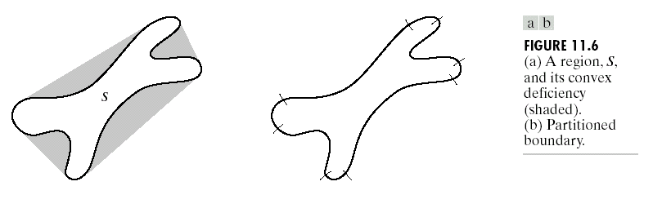
Boundary Segments
convex hull H of an arbitrary set S is the smallest convex set containing S
the set different H-S is called convex deficiency D of the set S

Slide 15
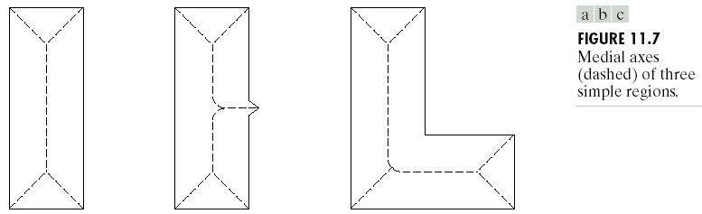
Skeletons
medial axis (skeleton)

Slide 16
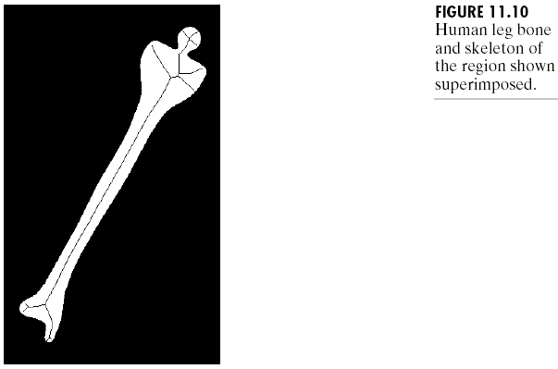
Example

Slide 17



Slide 18
Boundary Descriptors
length of a boundary
diameters
eccentricity
shape numbers

Slide 19
Length of a boundary
the number of pixels along a boundary
give a rough approximation of its length

Slide 20

Diameters
D is a distance measure
p_{i} and p_{j} are points on the boundary B

Slide 21
Eccentricity
ratio of the major to the minor axis
major axis = the line connecting the two extreme points that comprise the diameter
minor axis = the line perpendicular to the major axis

Slide 22
Regional Descriptors
area
perimeter
compactness
topological descriptors
texture

Slide 23
Simple descriptors
area = the number of pixels in the region
perimeter = length of its boundary
Compactness = (perimeter)²/area

Slide 24
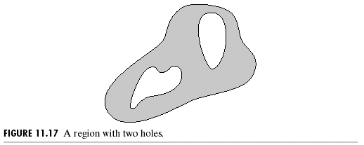
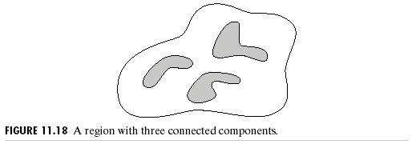
Topological descriptors
E = C - H
E = Euler number
C = number of connected region
H = number of holes

Slide 25
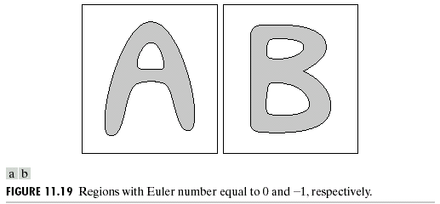
Euler number

